Slide 1

Introduction to NoSQL databases

Slide 2


Slide 3
One well-known open-source NoSQL database management system that is classified as a document-oriented database is MongoDB
Large volumes of unstructured or semi-structured data can be stored, queried, and processed using this MongoDB Inc.-developed system.
MongoDB stores data in flexible and dynamic documents that resemble JSON, using a document-oriented data model.

Slide 4
Key Features of MongoDB
Document-Oriented
NoSQL
Scalability
Indexes
Aggregation Framework
Replication and High Availability
Ad Hoc Queries
Open Source

Slide 5
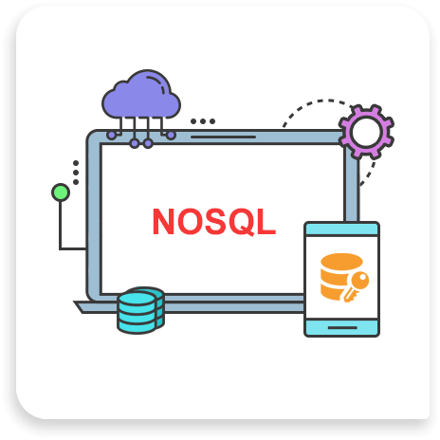

Slide 6
What is a NoSQL database
NoSQL databases, often referred to as "Not Only SQL" databases, are a type of database management system that provides a non-tabular storage mechanism for data. Unlike traditional relational databases, which store data in structured tables with predefined schemas, NoSQL databases are designed to handle a variety of data models, making them well-suited for handling unstructured, semi-structured, or rapidly changing data. Here's a more detailed definition:

Slide 7
Needs of NoSQL Database
Flexibility in Data Modeling
Scalability
Support for Complex Data Type
Handling Big Data
High Performance
Distributed and Fault-Tolerant Architectures
Cost Effective
Real Time Data Processing
Global Availability

Slide 8
Type of NoSQL Database
Document Database
Key-value Stores
These databases allow users to query data using document-oriented query languages and store data as semi-structured documents like XML or JSON.
These databases are designed for quick and easy read/write operations and store data as key-value pairs.
Column-family stores
Graph Database
These types of databases hold information in the form of sets of columns that are regarded as a single unit, called column families. They are designed to query massive volumes of data quickly and effectively.
Graph databases are made to manage intricate interactions between data by storing data as nodes and edges.

Slide 9
Key Features of Nosql Database
01
NoSQL databases don't have set schemas, they may adapt to changing data structures without requiring migrations or schema changes.
Dynamic Schema
02
NoSQL databases are ideal for handling massive volumes of data and significant traffic because they are made to scale up by adding more nodes to a database cluster.
Horizontal Scalability
03
Certain NoSQL databases, like MongoDB, store data in a scales-semi-structured format, such JSON or BSON, using a document-based data paradigm.
Document Based
04
Key-Value Based
Key-value data models are used by other NoSQL databases like Redis, where data is kept as an array of key-value pairs.

Slide 10
Key Features of Nosql Database
05
A column-based data model, which arranges data into columns rather than rows, is used by some NoSQL databases, such Cassandra.
Column Based
06
NoSQL databases frequently include highly available designs that automatically manage node failures and data replication amongst cluster nodes.
Distributed and High Availability
07
NoSQL databases provide a variety of data types and dynamic data structures, giving developers the flexibility and dynamic ability to store and retrieve data.
Flexibility
08
Performance
NoSQL databases are appropriate for big data and real-time applications because of their high performance optimization and capacity to manage large volumes of reads and writes.

Slide 11
Advantages of NoSQL database
Flexible data Models
Scalability
High Performance
Horizontal Partitioning
Fault Tolerance

Slide 12
Disadvantages of NoSQL Database
Lack of ACID Transactions
Learning Curve
Limited Query Capabilities
Lack of Standardization
Management Challenges
Data Consistency Challenges

Slide 13
Understand
The primary use case for NoSQL databases is managing enormous amounts of ______________ data.
A) unorganized
B) organized
C) semi-structured
D) all of the above
A

Slide 14
Understand
________ stores are used to hold data on social connections and other networks.
a) Key-value
b) Wide-column
c) Document
d) Graph
D

Slide 15
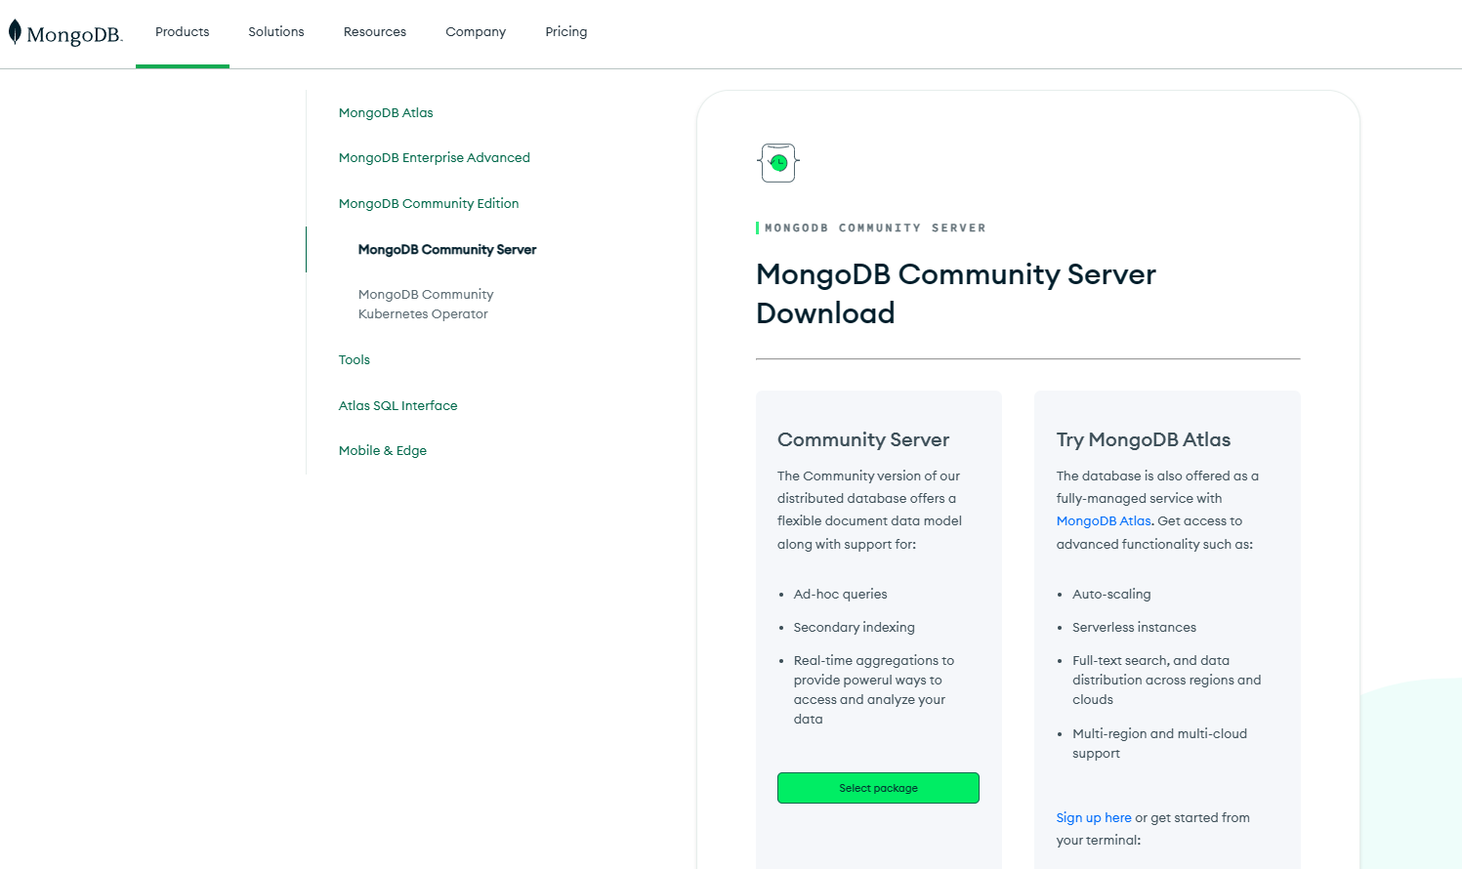
Installation and configuration of MongoDB
Step 1: First Visite MongoDB Download Center.

Slide 16
Installation and configuration of MongoDB
Step 1: First Visite MongoDB Download Center.

Slide 17
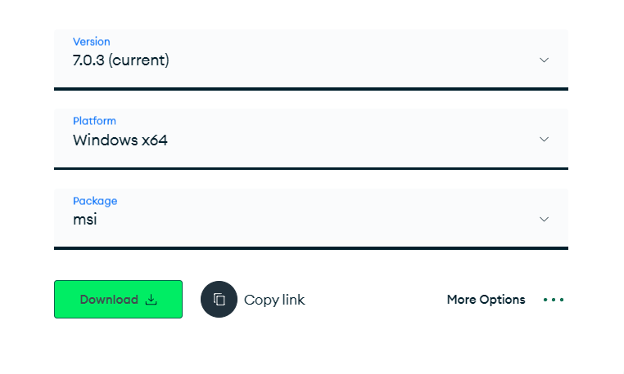
Installation and configuration of MongoDB
Step 2: Select the Version of MongoDB as per your requirements.

Slide 18
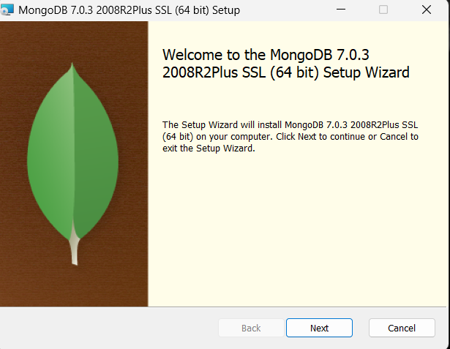
Installation and configuration of MongoDB
Step 3: Once download complete open the msi file and click on next button.

Slide 19
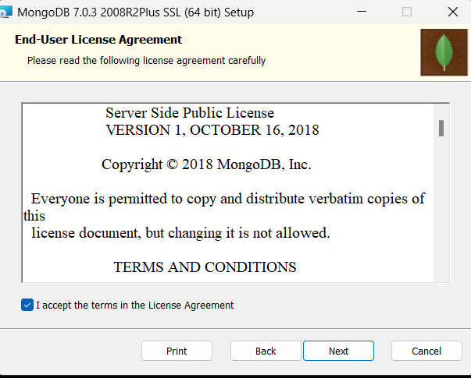
Installation and configuration of MongoDB
Step 4: Accept End-user licence agreement and click on next.

Slide 20
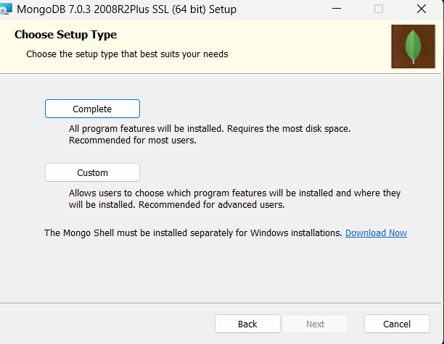
Installation and configuration of MongoDB
Step 5: Select complete option to download all program features. If you want to download some specific features then you can choose custom option.

Slide 21
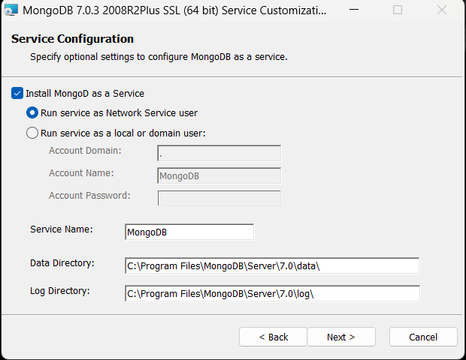
Installation and configuration of MongoDB
Step 6: Select Run service as Network Service User option and then copy Data Directory path and click on next.

Slide 22
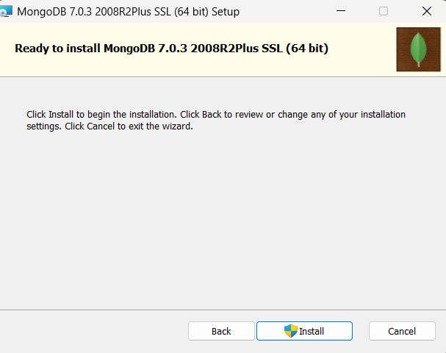
Installation and configuration of MongoDB
Step 7: Click on Install button and wait till application is getting Install.

Slide 23
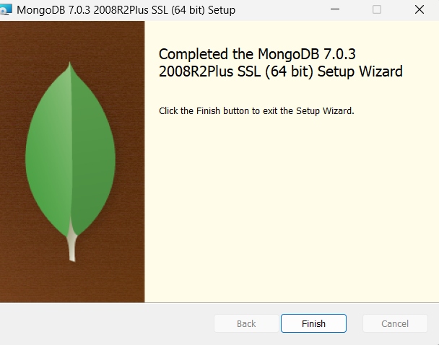
Installation and configuration of MongoDB
Step 8: Click on Finish Button once installation is complete.

Slide 24
Installation and configuration of MongoDB
Step 9: Now we have to set the Environment Variables path. Copied the path of file where we install the mongoDB. Then edit your Environment Variables and set the path.
Step 10: let's configure the weather MongoDB got download successfully or not. Open command prompt and run the MongoDB server by using mongod Command.
Step 11: Connect MongoDB server with MongoDB by using mongo command on command prompt , don't close the mongod command page keep it open create new prompt and write mongo command . once your server connected to database you are ready to execute any queries.

Slide 25
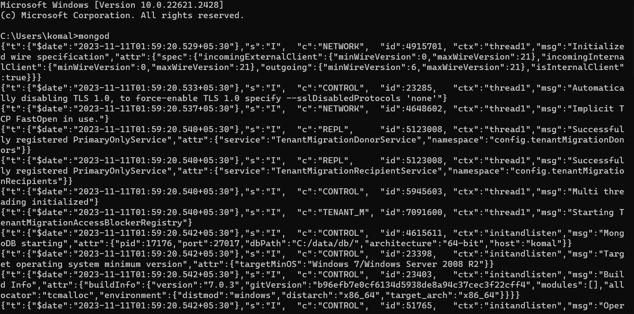
Installation and configuration of MongoDB

Slide 26


Slide 27
Thank You

